Slide 1
Digital Portfolio
Crafting a Comprehensive Showcase

Slide 2
Name : Jayaram M Register no and NMID : 212400942/44C2D1ACFE821B696FF4C546DD579FD3 Department : BCA College : PRINCE SHRI VENKATESWARA ARTS AND SCIENCE COLLEGE

Slide 3

Problem statement
Creating a personal digital portfolio is essential for showcasing skills, projects, and achievements. Many students and professionals lack an attractive, well-structured online portfolio, which limits opportunities for internships, projects, and jobs.
‎This project solves the problem by providing a clean, responsive, and interactive portfolio website.

Slide 4
Project overview
Developed a digital portfolio website to showcase personal skills, projects, and contact details.
‎
‎Built using HTML, CSS, and JavaScript.
‎
‎Features a smooth scrolling effect for better user experience.
‎
‎Includes sections like About Me, Skills, Projects, and Contact.

Slide 5
End users
‎The project is intended for:
‎
‎Students – to showcase skills and projects.
‎
‎Job Seekers – to present resumes interactively.
‎
‎Recruiters – to evaluate candidates easily.
‎
‎Personal Branding – for professionals wanting an online presence

Slide 6
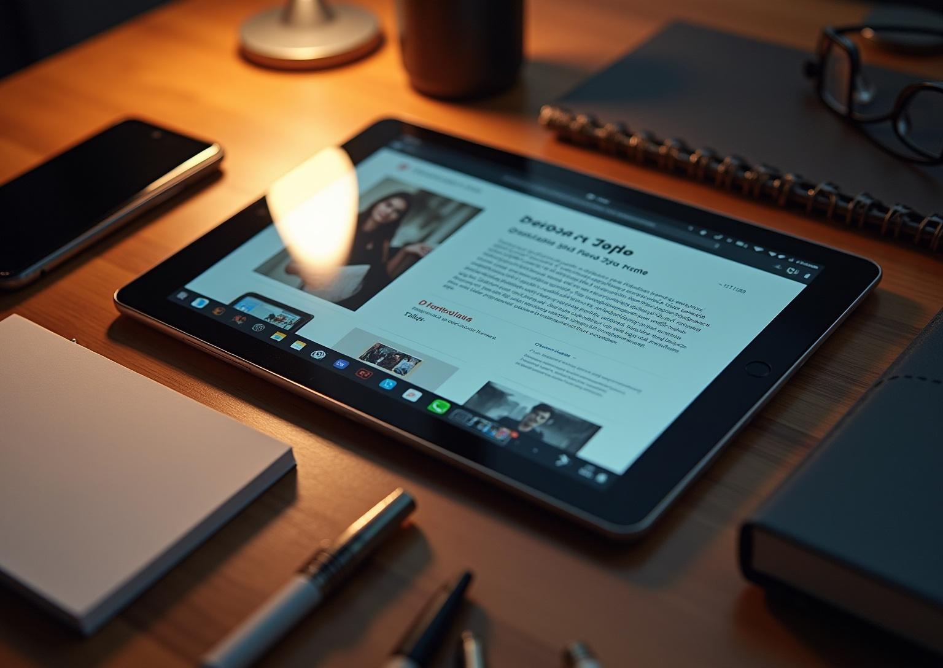
Tools and techniques
Technologies Used:
‎
‎HTML5 → Structure of the portfolio
‎
‎CSS3 → Styling and layout design
‎
‎JavaScript → Smooth scrolling & interactivity
‎
‎
‎Tools Used:
‎
‎CodePen (Development & Testing)
‎
‎VS Code (Optional for editing)
‎
‎GitHub (Version control & hosting)

Slide 7

Portfolio Design and Layout
‎Header Section → Navigation bar with smooth scrolling
‎
‎About Me Section → Brief personal introduction
‎
‎Skills Section → Highlights technical skills
‎
‎Projects Section → Describes completed projects
‎
‎Contact Section → Email & GitHub links
‎
‎Footer → Copyright information

Slide 8
Features and Functionality
Smooth Scrolling: JavaScript-powered scrolling for a better experience.
‎
‎Responsive Design: Works across devices (mobile, tablet, desktop).
‎
‎Interactive Navigation: Easy switching between sections.
‎
‎Showcase of Skills & Projects: Cleanly categorized for better readability.
‎
‎Contact Integration: Direct access to email & GitHub.
‎

Slide 9
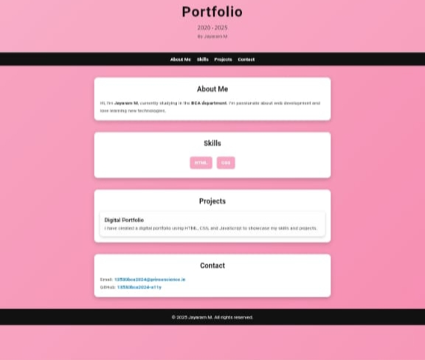
RESULT AND SCREEN SHOT

Slide 10
Conclusions
This project demonstrates web development skills using HTML, CSS, and JavaScript.
‎
‎Helps in showcasing skills, projects, and achievements in an attractive manner.
‎
‎Acts as a foundation for future enhancements like adding blogs, animations, and APIs.

